Slide 1
Project Management
Note: See the text itself for full citations.

Slide 2
Learning Objectives
Explain what a project is, list various attributes of projects, and describe the triple constraint of project management
Describe project management and key elements of the project management framework
Understand Project Management Institute (PMI), the importance of certification and ethics, and the advancement of project management software

Slide 3
Introduction
Many organizations today have a new or renewed interest in project management
Worldwide IT spending was $3.8 trillion in 2014, a 3.2 percent increase from 2013 spending
The Project Management Institute estimates demand for 15.7 million project management jobs from 2010 to 2020

Slide 4
Project Management Statistics
In 2013, the average salary for someone in the project management profession was US$134,658 in Australia, (the highest-paid country)
The top skills employers look for in new college graduates are all related to project management: team-work, decision-making, problem-solving, and verbal communications

Slide 5
Motivation for Studying Information Technology (IT) Project Management
IT Projects have a terrible track record ☹
Only 16.2% of IT projects were successful in meeting scope, time, and cost goals
Over 31% of IT projects were canceled before completion
Only 2.5% of corporations consistently meet their targets for scope, time, and cost goals for all types of project.

Slide 6
Advantages of Using Formal Project Management
Better control of financial, physical, and human resources
Improved customer relations
Shorter development times
Lower costs
Higher quality and increased reliability
Higher profit margins
Improved productivity
Better internal coordination
Higher worker morale

Slide 7
What Is a Project?
A project is “a temporary endeavor undertaken to create a unique product, service, or result”
Projects end when their objectives have been reached or the project has been terminated
Projects can be large or small and take a short or long time to complete

Slide 8
Examples of IT Projects
A team of students creates a smartphone application and sells it online
A company develops a driverless car
A government group develops a system to track child immunizations
A global bank acquires other financial institutions and needs to consolidate systems and procedures

Slide 9

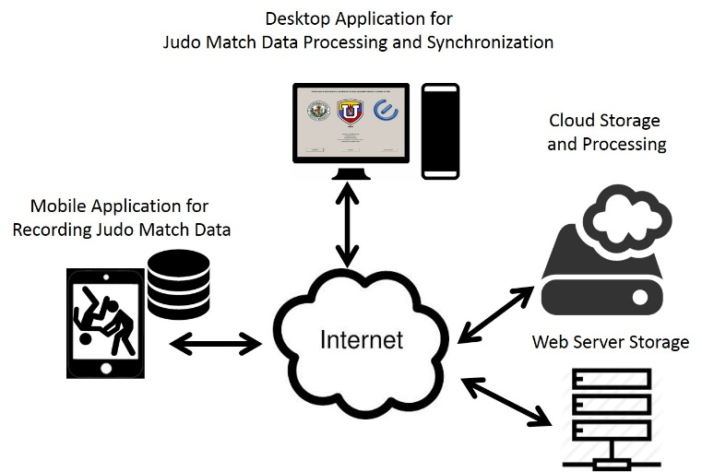




Examples of IT Projects
Internet
Recording, storing and querying judo match data using an Android tool and Cloud Computing
We want to provide Internet access to people living in slums
Use of camera surveillance in Islamabad
We want to provide Internet access to people living in slums

Slide 10

Examples of IT Projects
A Wiki describing two project management software (PMS) for the School of Engineering, Computer and Mathematical Science’s (SECMS) final year students to assist them in selecting one for their R&D project paper

Slide 11
Top Strategic Technologies
Computing everywhere
The Internet of things
3D printing
Advanced, pervasive, and invisible analytics

Slide 12



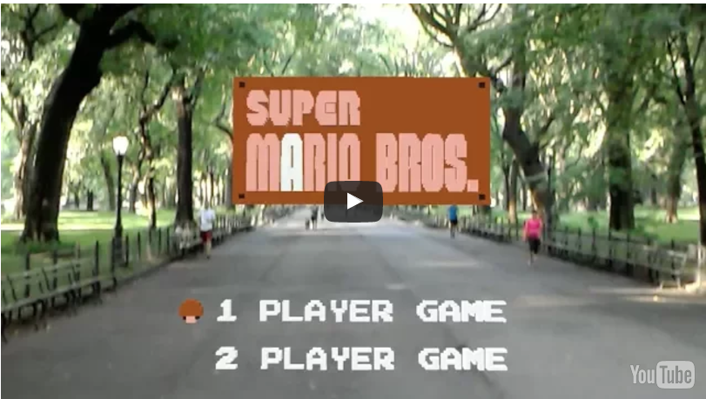

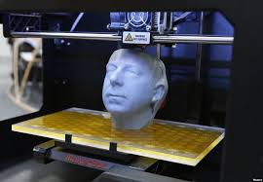
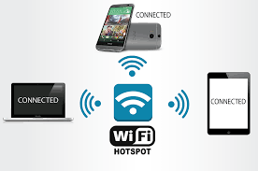






Strategic Technologies… but IT shouldn’t manage us, we should be able to manage the technology

Slide 13
Project Attributes
A project
has a unique purpose
is temporary
is developed using progressive elaboration
requires resources, often from various areas
should have a primary customer or sponsor
The project sponsor usually provides the direction and funding for the project
involves uncertainty

Slide 14
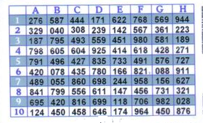


Project Attributes: Example
Unique purpose
Capture the information of a Security Bank Card and store encrypted data in the smartphone for future access of the security information
Temporary
Estimate Time
Deliverables every two weeks

Slide 15
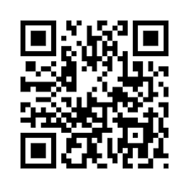


Project Attributes: Example
Developed using progressive elaboration
At the beginning, we knew that captured data should be encrypted. During the Project, we concluded that AES 256 (is a symmetric block cipher used to protect information) should be used. We also decided to use QR codes to store the security card numbers.
Resources
A Project leader
Two consultants
Four programmers
Four Android Smartphones
Four Desktop computers
Android Studio

Slide 16


Project Attributes: Example
Primary customer or sponsor
A sponsor from outside the University who provided guidance and funding for the project
Project involves uncertainty
We didn’t know if the digital image processing program could run on a smartphone efficiently.

Slide 17
A _________ is a temporary endeavour undertaken to create a unique product, service, or result
Program
Process
Project
Portfolio

Slide 18
Which of the following is not an attribute of a project?
Projects are unique
Projects are developed using progressive elaboration
Projects have a primary customer or sponsor
Projects involve little uncertainty

Slide 19

Project and Program Managers
Project managers work with project sponsors, project team, and other people involved in a project to meet project goals
Program: group of related projects managed in a coordinated way to obtain benefits and control not available from managing them individually
Program managers oversee programs; often act as bosses for project managers

Slide 20
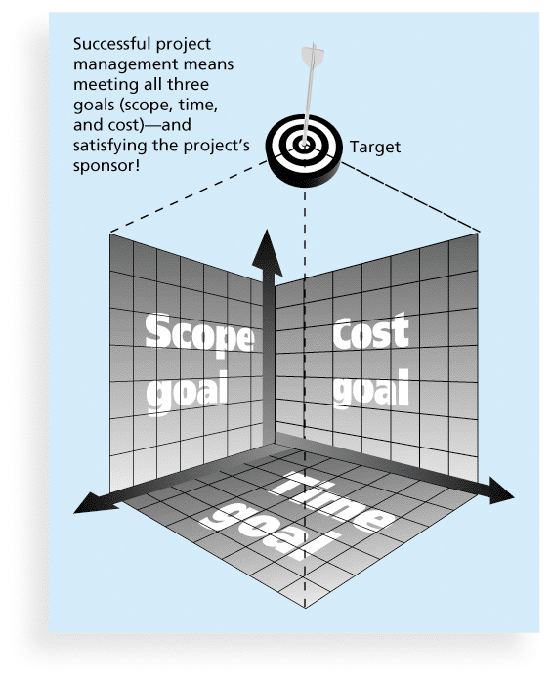
Figure 1-1 The Triple Constraint of Project Management

Slide 21
Figure 1-1 The Triple Constraint of Project Management
Scope
What work will be done?
What unique product will be delivered?
The result that the sponsor expects
Quality expectation?
Who validates the scope
Time
How long or duration of the project?
What is the project schedule?
How would the team track the actual schedule?
Who can approve the changes to the schedule?

Slide 22
Figure 1-1 The Triple Constraint of Project Management
Cost
What should it cost to complete the project?
What is the budget?
How will cost be tracked?
Who can authorize changes to the budget?

Slide 23
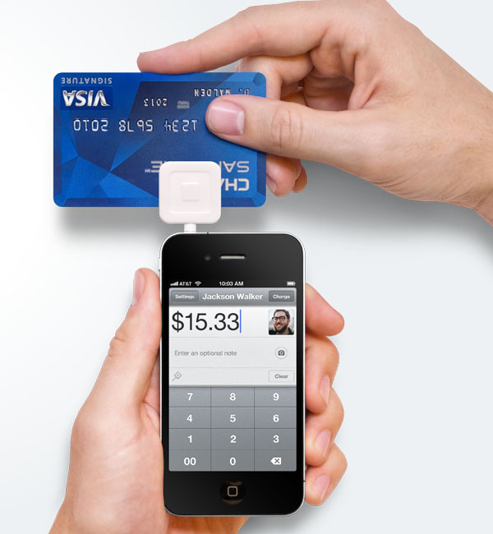
The Triple Constraint of Project Management: Example
Scope the application should work on any smartphone
Later the scope was adjusted to Android smartphones
Cost USD $14000 – USD $21000
Time between 6 and 8 months
Quality of the application

Slide 24
What is Project Management?
Project management is
“the application of knowledge, skills, tools and techniques to project activities to meet project requirements”
Project managers strive to meet the triple constraint (project scope, time, and cost goals) and also facilitate the entire process to meet the needs and expectations of project stakeholders

Slide 25
Project Management
“The general perception of most people is that project management started in the mid-20th century, or started earlier with Henry Gantt and his charts…Yet, how were all the great projects of the past delivered? Think about Giza Pyramid, the Parthenon, the Coliseum, the Gothic Cathedrals of Medieval Europe, the great voyages of exploration, the Taj Mahal, and the mega projects of the industrial revolutions. Was project management used on these projects? Were the concepts of project management even understood? Can we connect modern and ancient project management?” [1]
The answer is Yes
Project Management has been around since around 4500 years ago (since 2500 B.C.)
[1] Mark Kozak-Holland. The History of Project Management (Lessons from History). May, 2011.

Slide 26
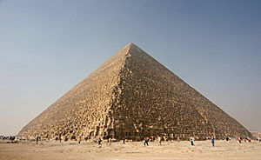

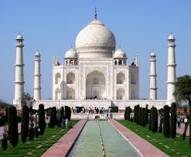
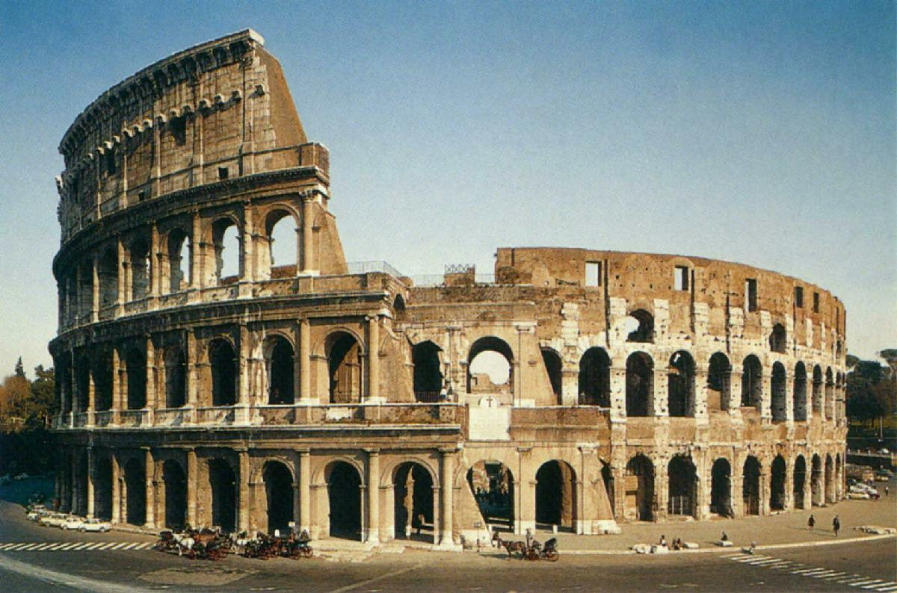
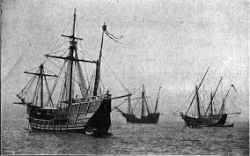
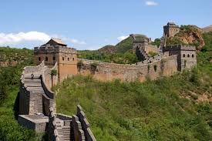
Great projects of the past
Identity the scope, resources, time of the Giza Pyramid project

Slide 27
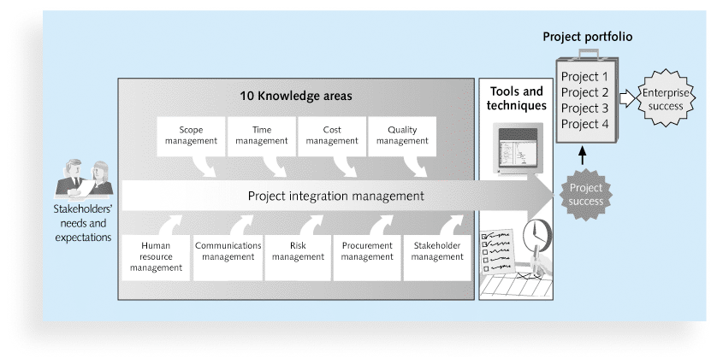
Figure 1-2 Project Management Framework

Slide 28
Project Stakeholders
Stakeholders are the people involved in or affected by project activities
Stakeholders include
the project sponsor
the project manager
the project team
support staff
customers
users
suppliers
opponents to the project

Slide 29



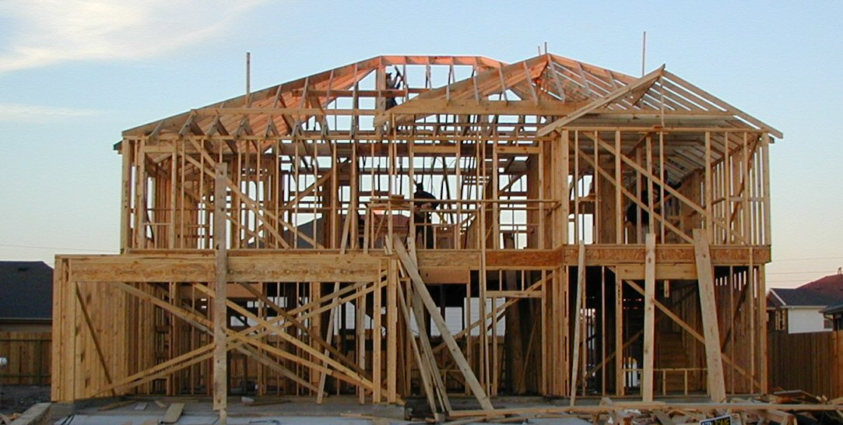

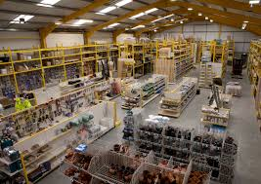


Stakeholders: Example
General contractor
Owner of the house
Legal owner
Construction workers
Suppliers
Opponents
Support staff

Slide 30

Stakeholders: Example
Sponsor
Project manager
Seven members of the Project team
Support staff:
Sponsor’s secretary
University administrative staff
(responsible for payment to Project team members)
Customers (Banks)
Users (persons who have security bank cards)
Suppliers (smartphone suppliers)
Opponents (Banks)

Slide 31
10 Project Management Knowledge Areas
Knowledge areas describe the key competencies that project managers must develop
Project managers must have knowledge and skills in all 10 knowledge areas
project integration, scope, time, cost, quality, human resource, communications, risk, procurement, and stakeholder management
You will learn them all from the lectures and Assignments

Slide 32
Project Management Tools and Techniques
Project management tools and techniques assist project managers and their teams in various aspects of project management
Some specific ones include
Project charter, scope statement, and WBS (scope)
Gantt charts, network diagrams, critical path analysis, critical chain scheduling (time)
Cost estimates and earned value management (cost)
See Table 1-1 for many more

Slide 33
Super Tools
“Super tools” are those tools that have high use and high potential for improving project success, such as:
Software for task scheduling (such as project management software)
Scope statements
Requirements analyses
Lessons-learned reports
Tools already extensively used that have been found to improve project importance include:
Progress reports
Kick-off meetings
Gantt charts
Change requests

Slide 34
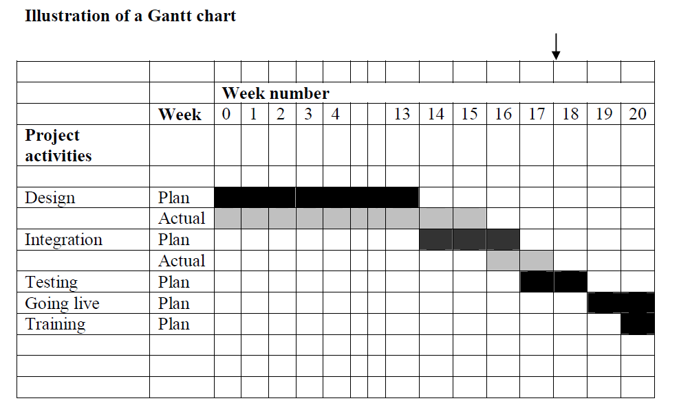
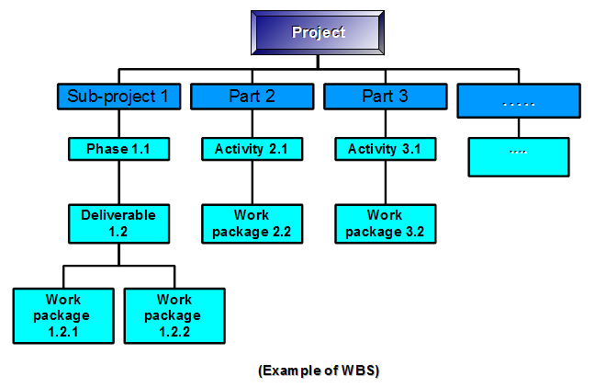
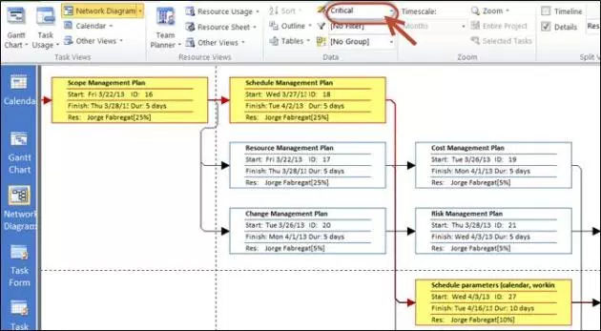
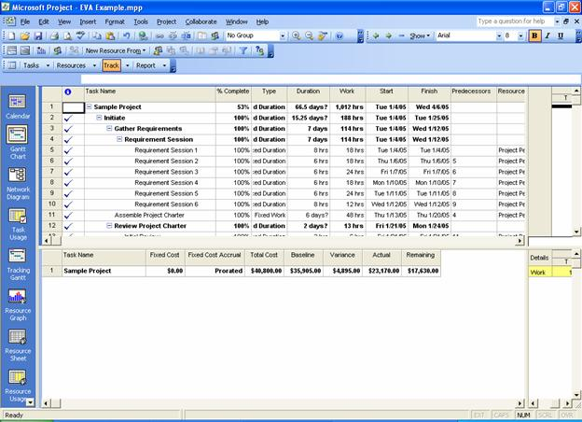

Slide 35
Project Success
There are several ways to define project success:
The project met scope, time, and cost goals
The project satisfied the customer/sponsor

Slide 36
Which of the following is not part of the triple constraint of Project management?
Meeting scope goals
Meeting time goals
Meeting communication goals
Meeting cost goals

Slide 37
Table 1-2: What Helps Projects Succeed?*
1. Executive support
2. User involvement
3. Clear business objectives
4. Emotional maturity
5. Optimizing scope
6. Agile process
7. Project management expertise
8. Skilled resources
9. Execution
10. Tools and infrastructure

Slide 38
The Role of the Project Manager
Job descriptions vary, but most include responsibilities like planning, scheduling, coordinating, and working with people to achieve project goals
Remember that 97% of successful projects were led by experienced project managers, who can often help influence success factors

Slide 39
Suggested Skills for Project Managers
The Project Management Body of Knowledge (PMBOK)
Application area knowledge, standards, and regulations
Project environment knowledge
General management knowledge and skills
Soft skills or human relations skills

Slide 40
Table 1-3 Ten Most Important Skills and Competencies for Project Managers
1. People skills
2. Leadership
3. Listening
4. Integrity, ethical behavior, consistent
5. Strong at building trust
6. Verbal communication
7. Strong at building teams
8. Conflict resolution, conflict management
9. Critical thinking, problem solving
10. Understands, balances priorities

Slide 41
Different Skills Needed in Different Situations
Large projects: Leadership, relevant prior experience, planning, people skills, verbal communication, and team-building skills were most important
High uncertainty projects: Risk management, expectation management, leadership, people skills, and planning skills were most important
Very novel projects: Leadership, people skills, having vision and goals, self confidence, expectations management, and listening skills were most important

Slide 42
Importance of Leadership Skills
Effective project managers provide leadership by example
A leader focuses on long-term goals and big-picture objectives while inspiring people to reach those goals
A manager deals with the day-to-day details of meeting specific goals
Project managers often take on the role of both leader and manager

Slide 43
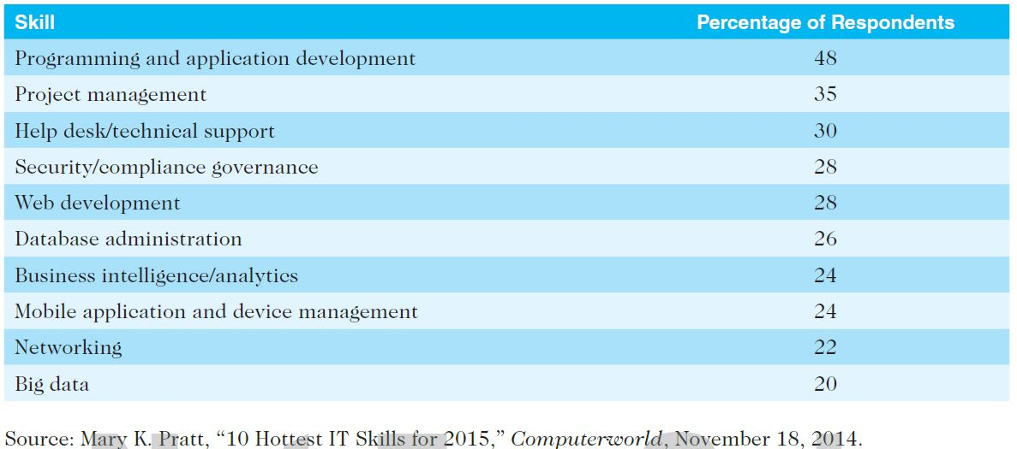
Table 1-4. Ten Hottest IT Skills
Even if you choose to stay in a technical role, you still need project management knowledge and skills to help your team and organization

Slide 44
The Project Management Institute
The Project Management Institute (PMI) is an international professional society for project managers founded in 1969
PMI provides certification as a Project Management Professional (PMP)
A PMP has documented sufficient project experience, agreed to follow a code of ethics, and passed the PMP exam

Slide 45
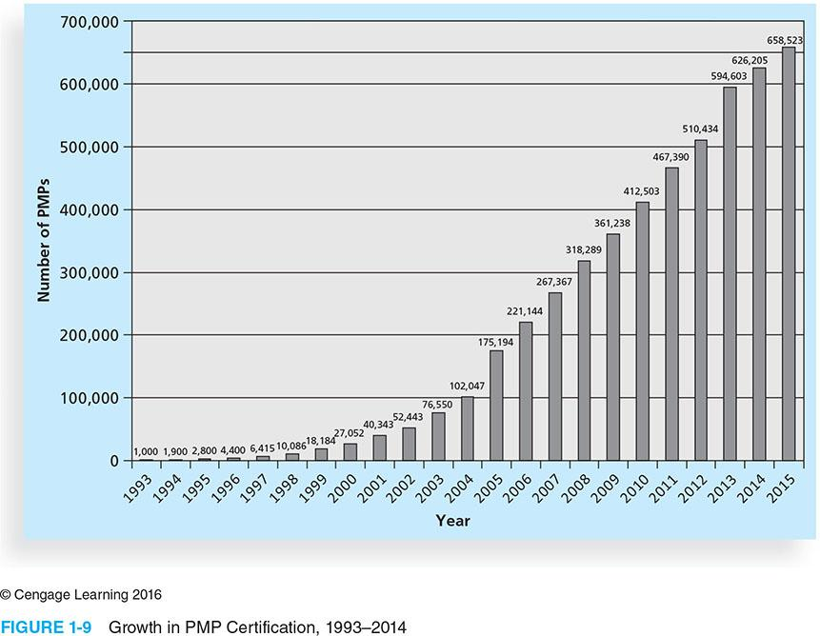
Figure 1-9 Growth in PMP Certification, 1993-2014

Slide 46
Ethics in Project Management
Ethics, loosely defined, is a set of principles that guide our decision making based on personal values of what is “right” and “wrong”
Project managers often face ethical dilemmas
Example?

Slide 47
Project Management Software (PMS)
Three main categories of tools:
Low-end tools: Handle single or smaller projects well, cost under $200 per user
Midrange tools: Handle multiple projects and users, cost $200-$1,000 per user, Project 2013 most popular
High-end tools: Also called enterprise project management software, often licensed on a per-user basis
Several free or open-source tools are also available

Slide 48

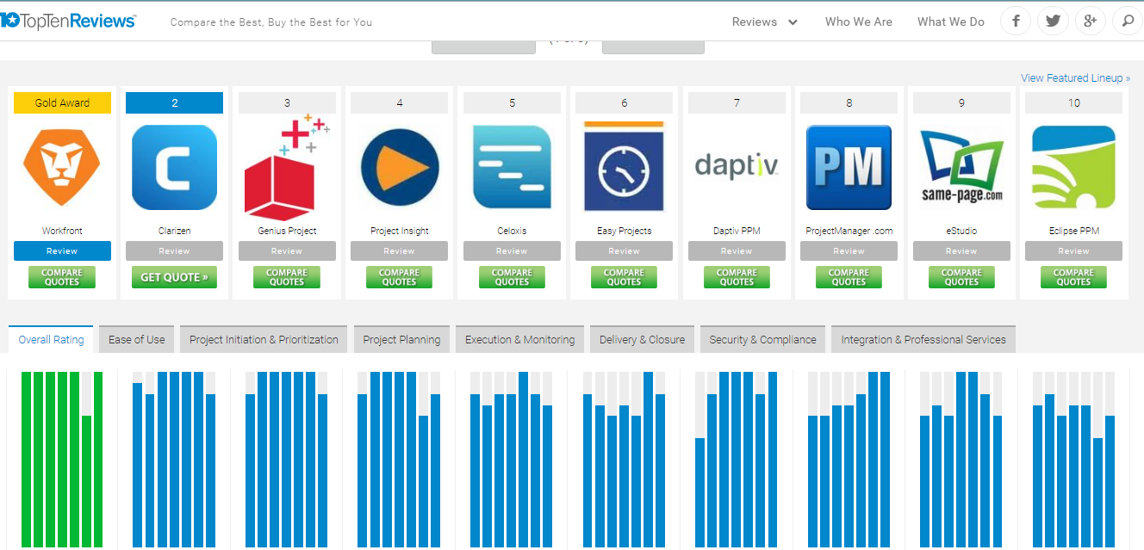
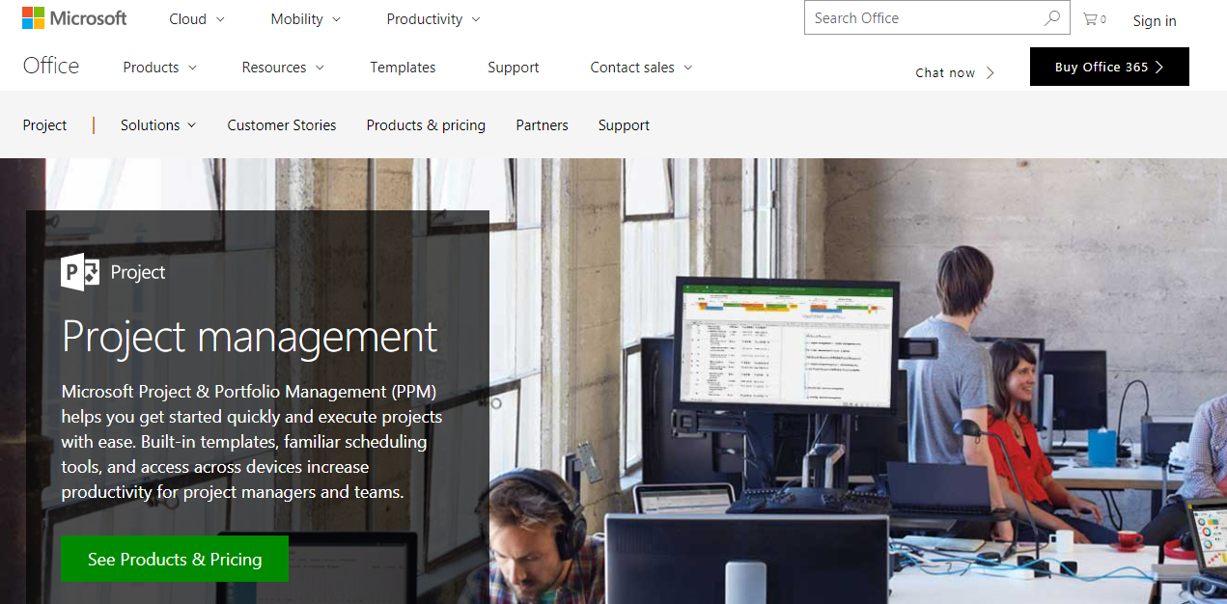

Slide 49
The Context of IT Projects
IT projects can be very diverse in terms of size, complexity, products produced, application area, and resource requirements
IT projects use diverse technologies that change rapidly. Even within one technology area, people must be highly specialized
IT project team members often have diverse backgrounds and skill sets

Slide 50
Project Phases and the Project Life Cycle
A project life cycle is a collection of project phases that defines
what work will be performed in each phase
what deliverables will be produced and when
who is involved in each phase, and
how management will control and approve work produced in each phase
A deliverable is a product or service produced or provided as part of a project

Slide 51
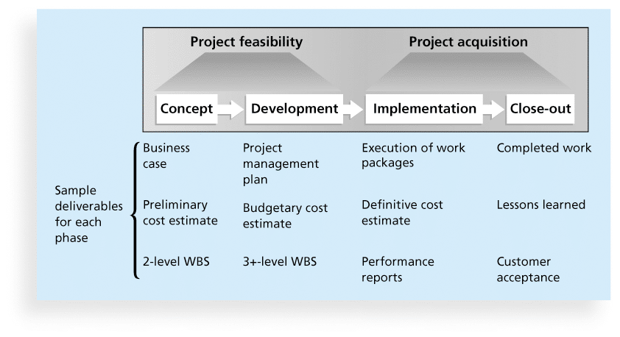
Figure 2-4. Phases of the Traditional Project Life Cycle

Slide 52
Systems Development Life Cycles
The Systems Development Life Cycle (SDLC) is a framework for describing the phases involved in developing and maintaining information systems
Systems development projects can follow
Predictive life cycle: the scope of the project can be clearly articulated and the schedule and cost can be predicted
Adaptive Software Development (ASD) life cycle: requirements cannot be clearly expressed, projects are mission driven using time-based cycles to meet target dates

Slide 53
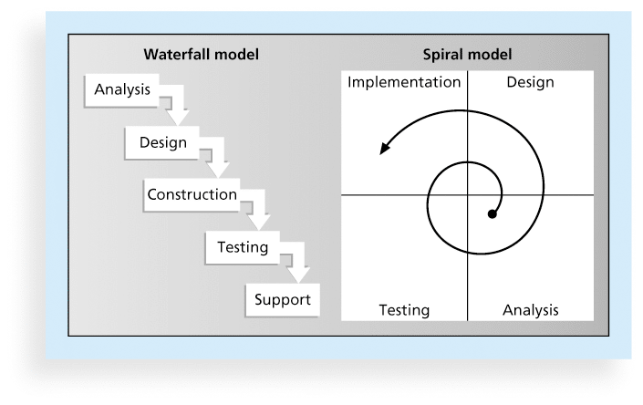
Figure 2-5. Waterfall and Spiral Life Cycle Models

Slide 54
Agile Software Development
Agile software development has become popular to describe new approaches that focus on close collaboration between programming teams and business experts
As technology and businesses became more complex, the approach was often difficult to use because requirements were unknown or continuously changing.

Slide 55
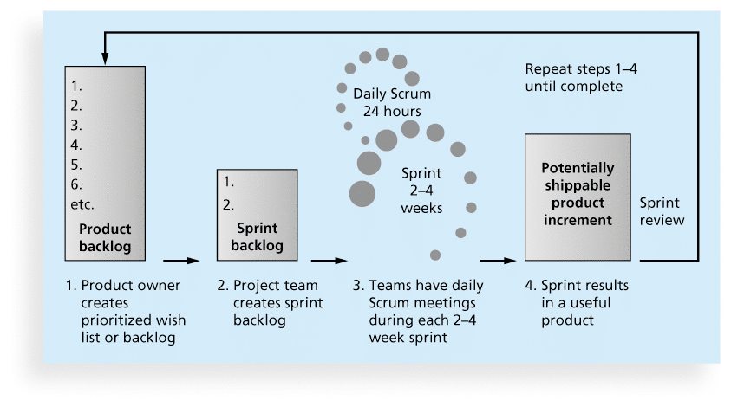
Figure 2-6. Scrum Framework

Slide 56
Any question?

